Slide 1

Lean, Kanban, & Poker Technique

Slide 2
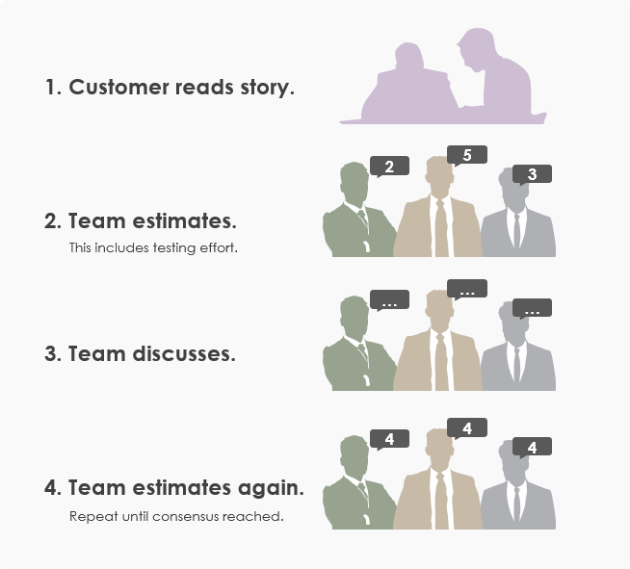
Poker Technique

Slide 3
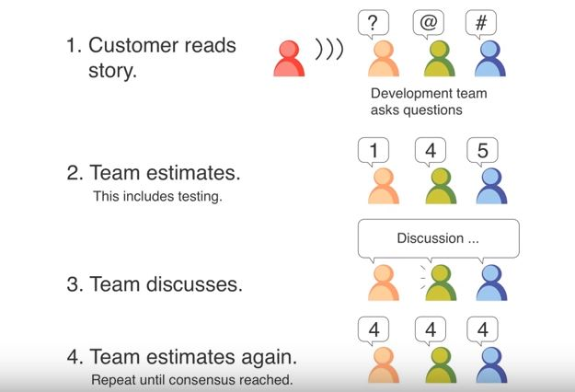
Poker Technique

Slide 4
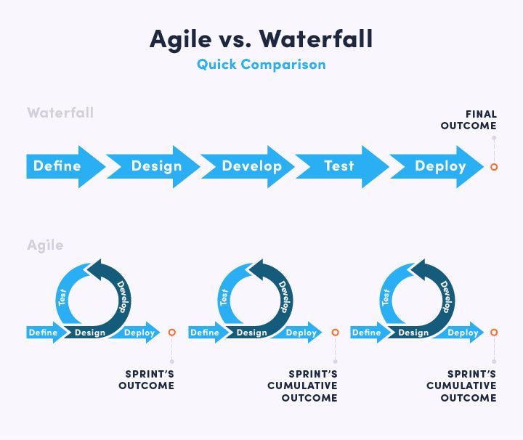

Slide 5

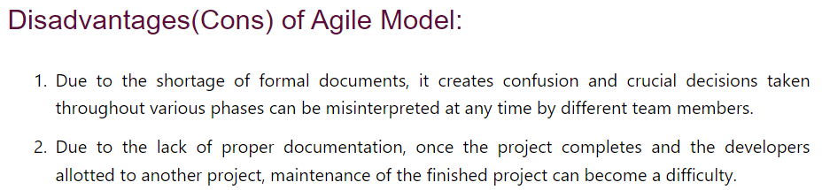
https://www.javatpoint.com/software-engineering-agile-model

Slide 6
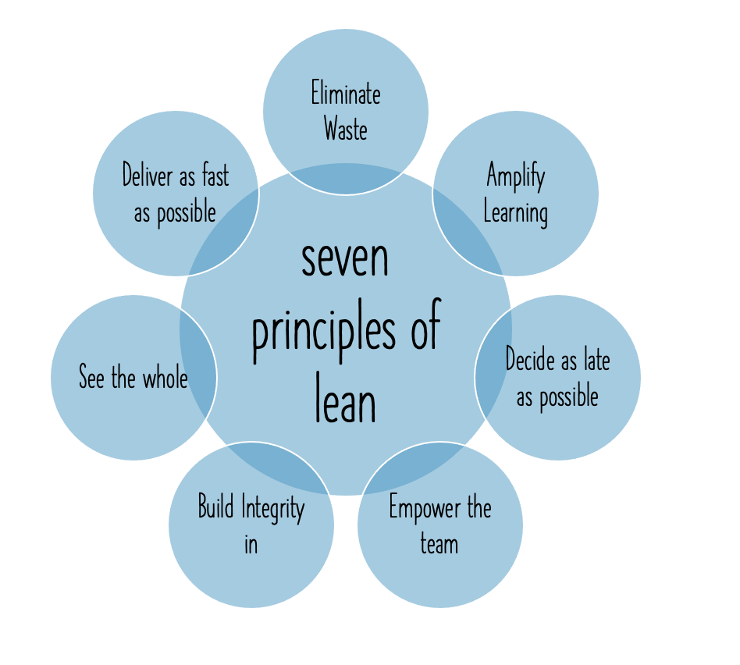
Lean PM Methodology

Slide 7
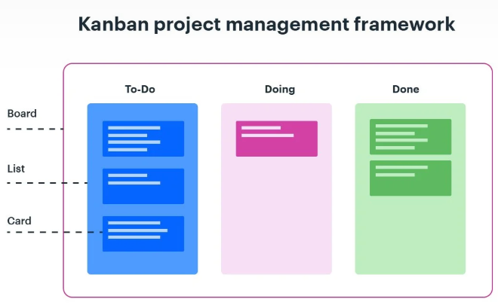
Kanban PM Methodology

Slide 8
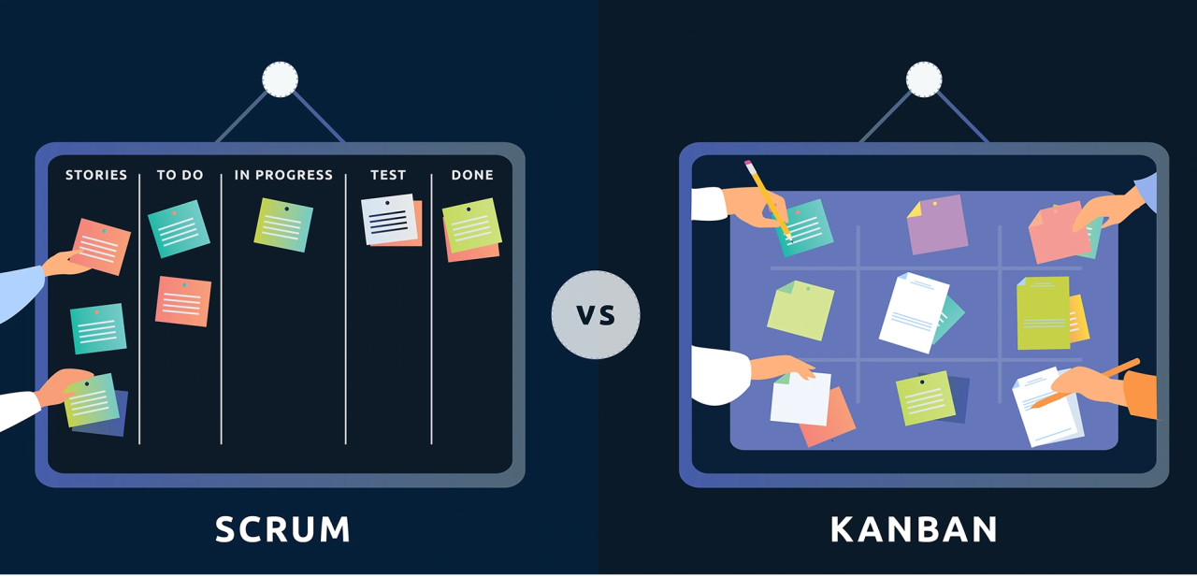
Scrum vs. Kanban

